Slide 1
Music Recommendations on Million Songs Dataset
Sai Prasanna Kumar Kumaru
Sai Teja Kandukuri
Neeharika Yeluri

Slide 2
Overview
Overview
Introduction
Datasets
Exploratory Data Analysis
Algorithms
Results
Conclusion
Challenges

Slide 3
INTRODUCTION
The Million Song Dataset contains audio features and metadata for one million songs.
The Taste profile dataset is a subset of the Million Song Dataset that includes user-song-play count triplets, artist and song metadata.
The project involves data preprocessing, exploratory data analysis, feature engineering, and building and evaluating different recommendation algorithms.
The project aims to build a personalized music recommendation system that delivers a satisfying music experience to users.

Slide 4
DATASETS
Dataset: Million Song Dataset
MSD Full Dataset:
1,019,318 - unique users
384,546 - unique MSD songs
48,373,586 - user-song-play_count triplets
TasteProfile Dataset - Triplets [1] - User ID, Song ID, Play count
Additional Datasets:
Meta Data [2] -
Track ID, title, song_id, Release, artist_id, artist_mbid, artist_name, duration, artist_familiarity, artist_hotttnesss, year, track_7digitalid, shs_perf, shs_work
Lyrics Data [3] -
Track ID, mxm_track_id, word_count

Slide 5
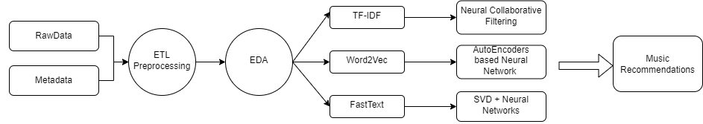
Data Preprocessing
The data preprocessing stage involved two types of data: interaction data(play count triplets), metadata and lyrics data.
Outliers in the user song play counts of interaction data were removed using interquantile range.
The play counts were kept within the range of 1 to 6.
In the metadata, irrelevant columns were removed and NaN values were also removed.
Text columns such as release, title, and artist name were preprocessed using NLP techniques.

Slide 6
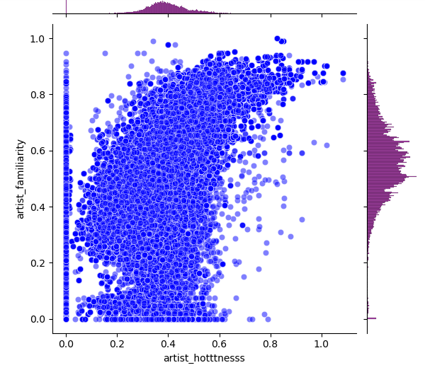
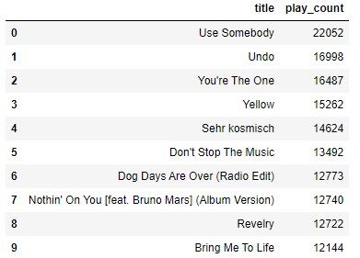
Exploratory Data Analysis - Song
The most popular song in the taste profile subset is "Use Somebody" with 22052 play counts.
There is a positive correlation between the two variables, indicating that popular artists tend to be more well-known.

Slide 7
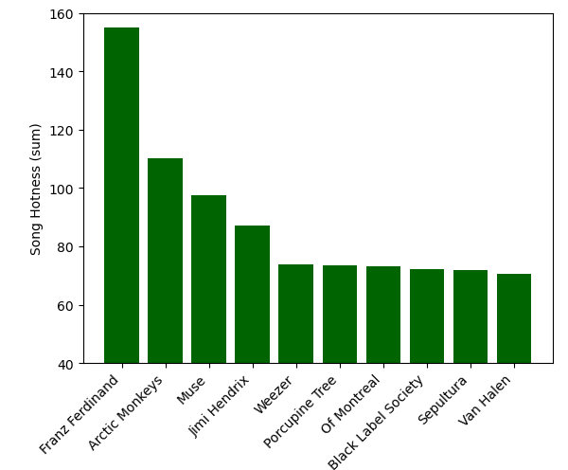
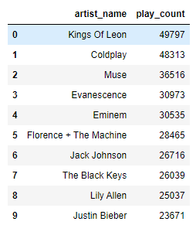
EDA - Artists
Top 10 artists based on play count and song hotness.

Slide 8
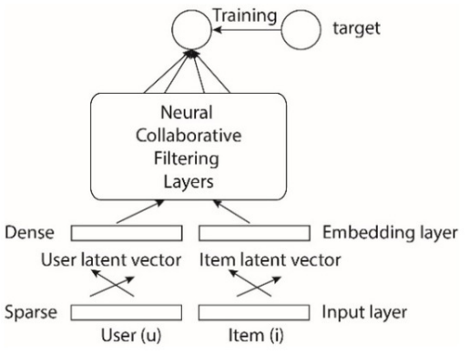
Neural Collaborative Filtering
A collaborative filtering approach was used to predict song recommendations for a user using play count and song likeness data, as well as metadata.
The model was trained using the Adam optimizer with a learning rate of 0.001 and a batch size of 64, MSE as the loss function and RMSE as the evaluation metric.
Early stopping was used to prevent overfitting and validate the model's performance.
song likeness = play count of the song listened by a user / total song play counts of the user

Slide 9
Hybrid Recommender System - Auto Encoder
A hybrid recommender system using Autoencoders combines both collaborative filtering and content-based filtering techniques.
Involves encoding user and item features using deep neural networks to generate recommendations, which can handle sparse data more effectively than traditional collaborative filtering techniques.
The model utilizes both user-song-playcount triplet interaction data and metadata(text and numerical columns).
Used Word2Vec model to generate embeddings for text
An autoencoder is used for the metadata input layer, where dense layers are defined for encoding and decoding metadata information.
MetaData
User ID
Song ID
AutoEncoder
Embeddings
Embeddings
Concatenate
Dense
Output

Slide 10
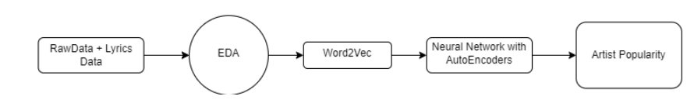
Predicting Artist Popularity
The metadata is passed through a Word2Vec model to generate embedding vectors, which are later attached to numerical columns to form an array with all metadata information.
The encoded layer is merged with the embedding output of interaction data, and the output of the merged layer is passed through several dense layers with dropout regularization.
The output of the model represents the predicted rating, which can be used to recommend songs to the user based on their preferences and behavior.

Slide 11
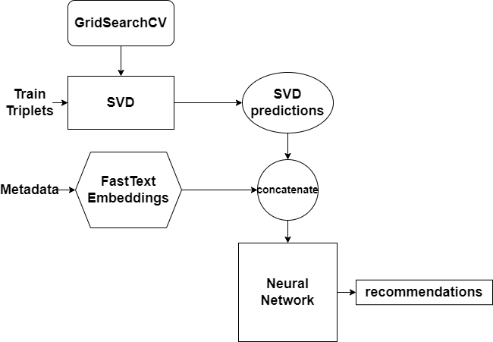
SVD and Neural Network
SVD can learn underlying patterns from data to reconstruct the original data to make predictions for missing targets.
SVD along with neural network is used to capture complex representations and other factors that SVD couldn’t learn.
SVD is trained from best parameters obtained using GridSearchCV and play_count predictions are generated.
For the neural network, textual data is encoded using FastText.
SVD predictions, numerical metadata, textual representations and user item embeddings are trained with the neural network.

Slide 12
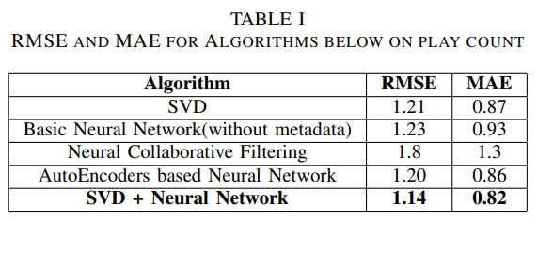
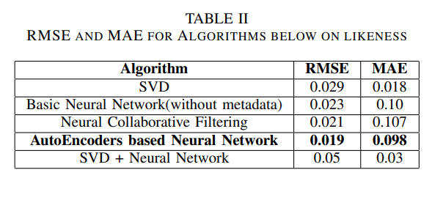
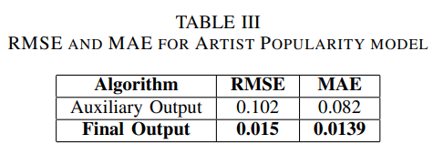
Results

Slide 13
Conclusion
The SVD + NN approach had the best performance on the recommendation task with RMSE and MAE values of 1.16 and 0.81, respectively, followed by AutoEncoders based Neural Network and Basic Neural Network.
For likeness prediction task, the AutoEncoders based Neural Network had the best performance with RMSE and MAE values of 0.019 and 0.098, respectively, followed by Neural Collaborative Filtering and Basic Neural Network.
The neural network model with auxiliary input and output achieved better performance than the model with only a final output layer, and including artist familiarity improved the model's ability to predict artist popularity accurately.
Incorporating artist familiarity had a positive impact on artist popularity prediction, and this finding could be useful for music industry professionals interested in identifying the factors that contribute to an artist's popularity.

Slide 14
Challenges
One of the main challenges faced during the development of the music recommendation system was the inclusion of lyrics data due to missing values.
We had to find a way to address the missing values issue to ensure the model was trained effectively and provided accurate recommendations.
The dataset used in the project was huge, which made it difficult to implement similarity-based approaches for recommendations.
Despite the challenges, we explored other options and came up with several effective recommendation algorithms based on the available data.

Slide 15
REFERENCES
http://millionsongdataset.com/tasteprofile/
http://millionsongdataset.com/pages/getting-dataset/#subset
http://millionsongdataset.com/musixmatch/

Slide 16
THANK YOU

